Slide 1
Discussion on:
Yorick Wilks’
Companionable Agents

Slide 2
Companionable Agent
Keep you company
  Watch TV with you
  Discuss a book
Put your life in order
  Appointments
  Grocery
  ?
Information of a whole life
  Photographs
  Medical information

Slide 3
Companions
Companionship Conversation
  Cheerful
  Helpful
  Trustworthy
  Discrete -> IMPORTANT ISSUE
    Who has access to this information
    Good points/Bad points
Task-driven Conversation (Type systems)
  Purchasing tickets
Task and non-task:
  Counseling
    Medical Procedure
  Debriefing

Slide 4
Types of Companions
NASA Companion
  Company on your way to Mars
Other Isolation Companion
  Prisons?
Virtual Victorian Lady’s Companion
  Older Person Companion
    Old age is a ship wreck
  Nanny?
Health Companion
Others?

Slide 5
Questions about Companions
Companion as interface to the world?
  Medical decisions
  Telemarketers
What happens to your companion when you die?
  Relatives have your companion to …
    Show: Black Mirror Season 2, Episode 1: Be right back
    New online service that lets people stay in touch with the deceased through a virtual avatar
      Developed using: past online communication and social media profiles

Slide 6
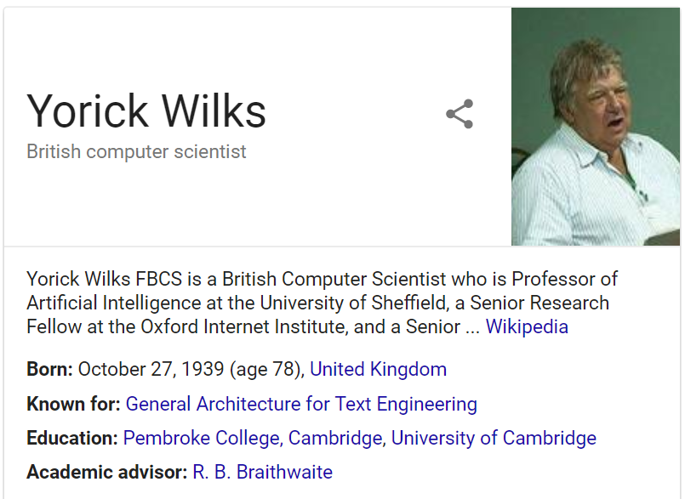
Tell me about Dr. Wilks?

Slide 7
What was the main theme?

Slide 8
What was the most important point in your opinion?

Slide 9

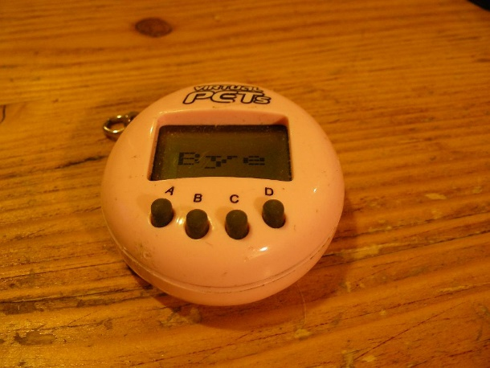


People will form relationships with anything
Manual things
  Furbies
  Virtual Pets
  Primo Puel
  Avatars
  ?

Slide 10

Facts

Slide 11
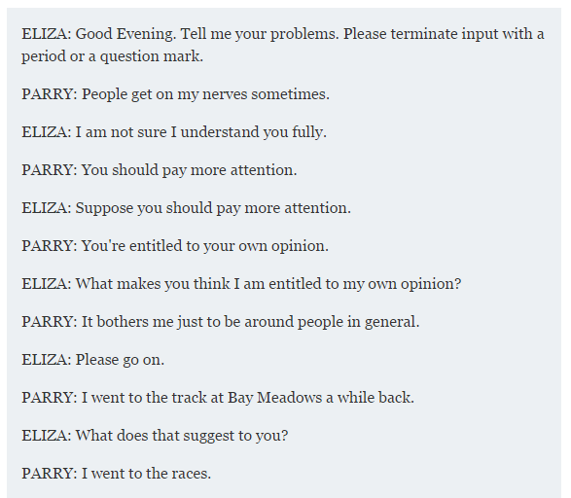
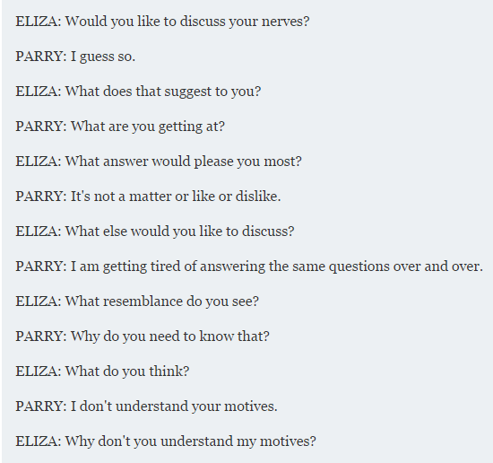
ELIZA and PARRY
PARRY
  Virtual Pyscotherapist
  Developed by a psychiatrist Kenneth Colby in 1972

Slide 12
Emotion Detection
Theories of emotion
  Platitude:
    e.g. Emotion is about frustrated plans
      Sometimes it is, sometimes it isn’t
Difficult to identify emotion
Once you identify it, what do you do with that information?

Slide 13
Real world knowledge of the world
Bringing in real world knowledge of the world
  Internet makes that possible now
    News
    Facebook
    ?
  Problem: what information is relevant

Slide 14
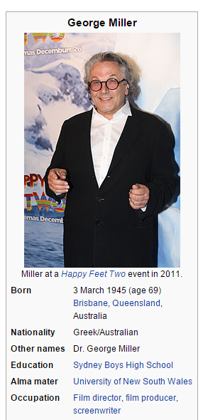
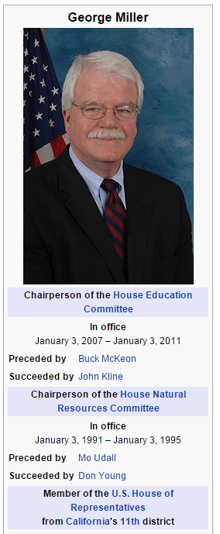
Get by without listening closing
Structure information
  Triple information
  Simple reasoning
  Simple inference
Since we don’t use all the information that comes in
  Do computers?
Computational Framework
  Semantics
    Ambiguity
      People

Slide 15
Rule-based vs Statistics
Rule–based
  Provides structure
Statistics
  Based on what is commonly seen in the world
    What is the world?

Slide 16
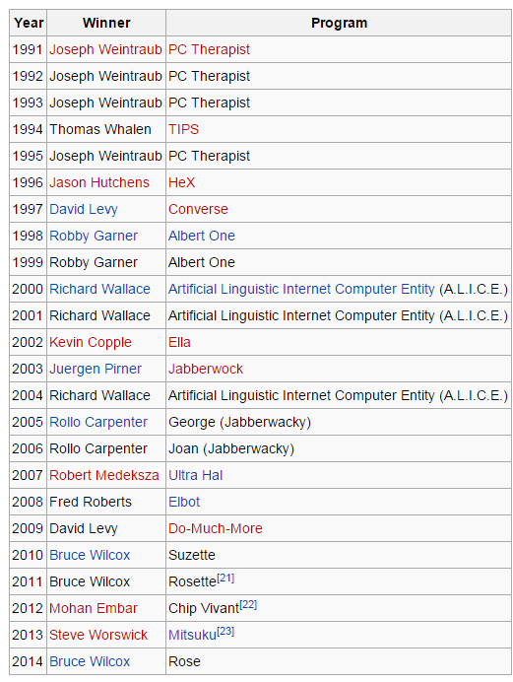
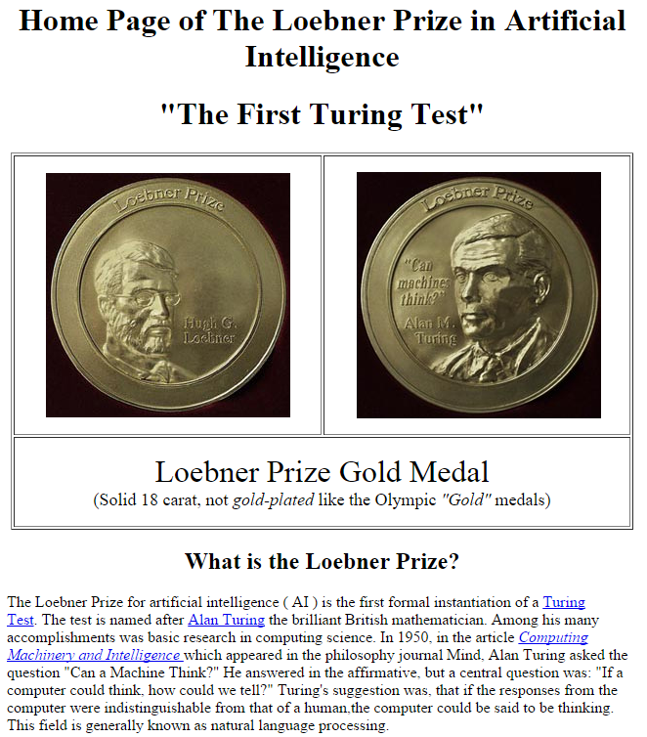
Loebner Contest

Slide 17
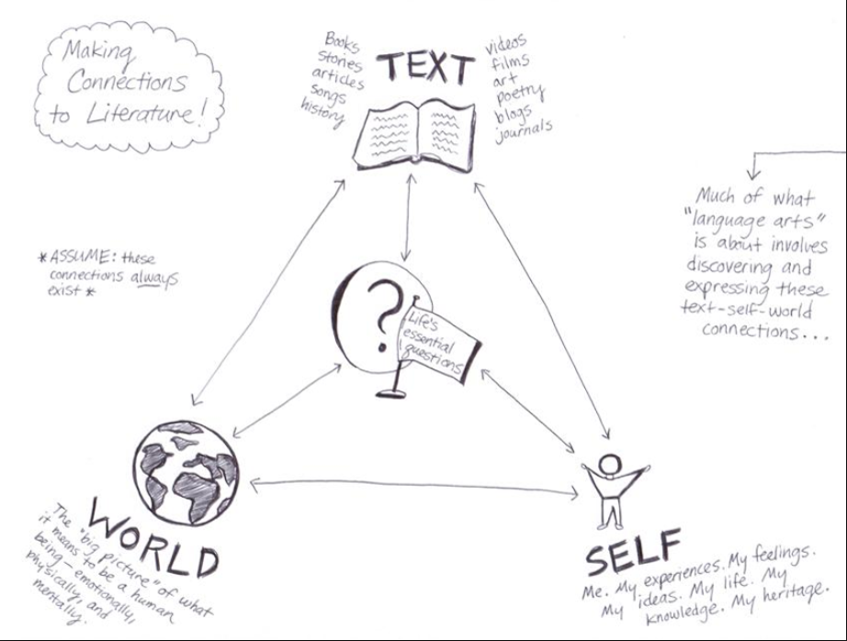
How does this discussion link to what we have learned in class (or another class)

Slide 18
Next week
Monday
  Programming Assignment 1 is due
  Lecture: Ngrams
  Handout: Lancashire & Hirst
Wednesday
  Lecture: Smoothing
Friday
  Paper: Lancashire & Hirst

